Slide 1
UW – Madison GI Tract Image Segmentation
Praneet Kumar Alamuri, Shreyansh Agrawal, Manvi Goyal, Aashi Aashi, Apurva Audi

Slide 2
Agenda
01
Problem Statement
04
Methodology and Modelling
02
Data Description
05
Results and Conclusion
03
Pre-Processing
06
Future Scope

Slide 3
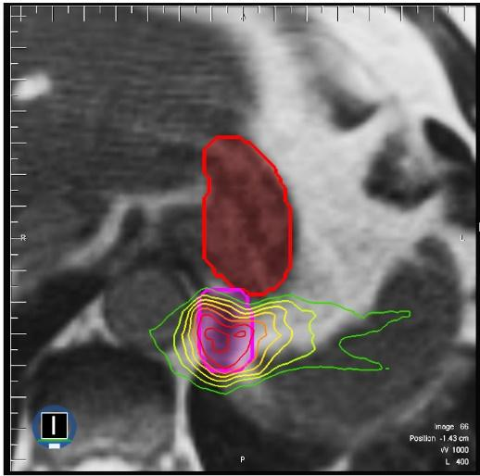
Treatment of Gastrointestinal Cancer
Around 5 million people are diagnosed with cancer of the gastrointestinal tract worldwide.
Radiation oncologists deliver high doses of radiation using X-ray beams pointed at tumors while avoiding the stomach and intestines.
Oncologists manually outline the position of the stomach and intestines in order to adjust the direction of the X-ray beams to target the tumor and avoid the stomach and intestines
This is a time-consuming and intensive process that can prolong treatments from 15 minutes a day to an hour a day
* This problem is part of a Kaggle competition (Link)
Insert Image of an MRI scan to basically show via is it difficult
The tumor (pink line) is close to the stomach (red line)

Slide 4
Problem Statement
We want to segment the stomach, large intestine, and small intestine on MRI scan images using semantic image segmentation to accurately deliver radiation doses to GI tract tumor patients while avoiding the stomach and intestines
This will help doctors deliver effective and faster treatment to cancer patients

Slide 5




Dataset
Image Scans
Cases
Input File
This dataset is part of the Kaggle Competition UW-Madison GI Tract Image Segmentation to track healthy organs in medical scans to improve cancer treatment. We are using anonymized MRI scan images sourced from UW’s Cancer Center.
16-bit gray scale in PNG format with annotations as RLE-encoded masks and different scans
Each case identified by day of scan with total scans of 38.5k
Image scans for each case with csv file consisting of id, predicted class & Encoded RLE pixels

Slide 6
Methodology
Data Pre-Processing
EDA
Model Training
Evaluation & Inferences
1
2
3
4
Cleaning, normalizing, RLE Decoding and vectorizing the images to create dataset for training
Visualizing the images and understanding the proportion of data available in each segments
We trained 4 different models using UNET and LinkNet architectures
Comparing the model performances on test set and interpreting the pixel importance
Notes:
Vanilla UNET Model
UNET Model with RESNET Backbone
LinkNET Model with RESNET Backbone
UNET Model with inceptioncv Backbone

Slide 7
Investigating Image Sizes and Masks
Total images : 38,496
Annotation Segments : no annotation (56%) , single (6%) , double (28%) , all segments (10%)
Image Sizes : 266 * 266 (67%) , 310 * 310 (29%) , 276 * 276 (3%) , 234 * 234 (1%)
Below is the share of training images with respective masks

Slide 8
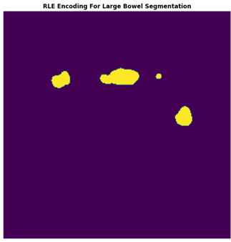
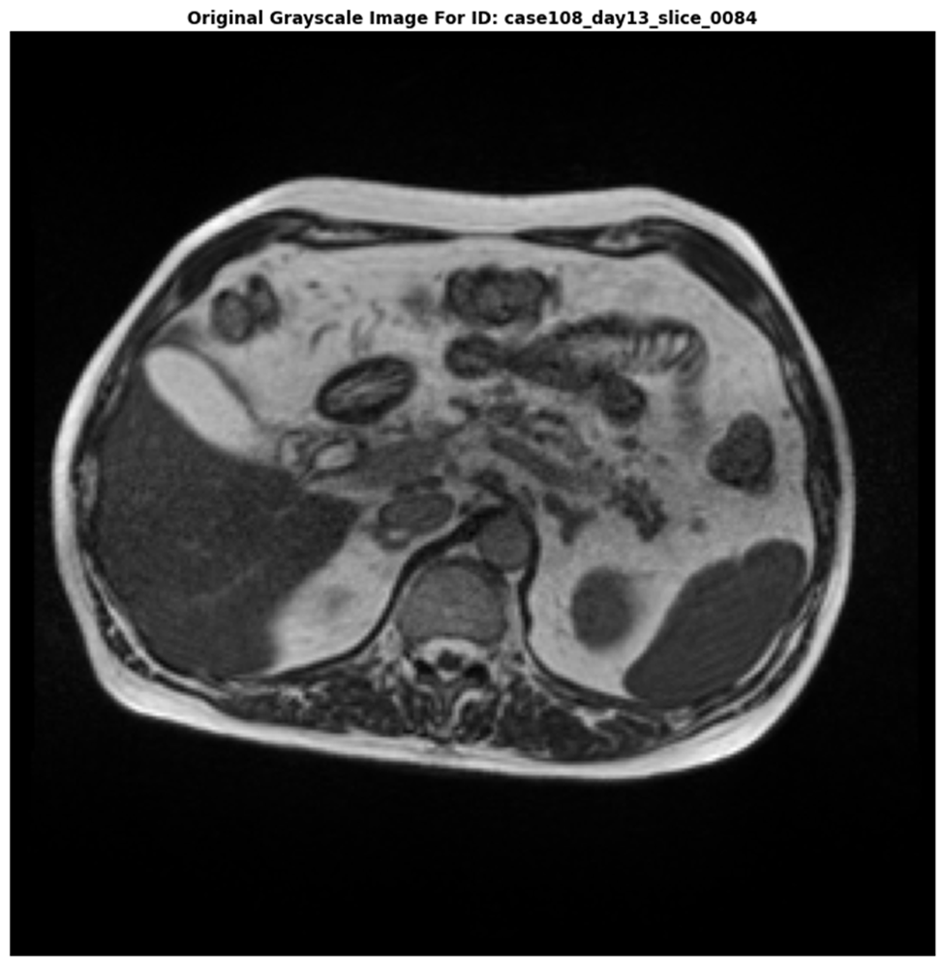
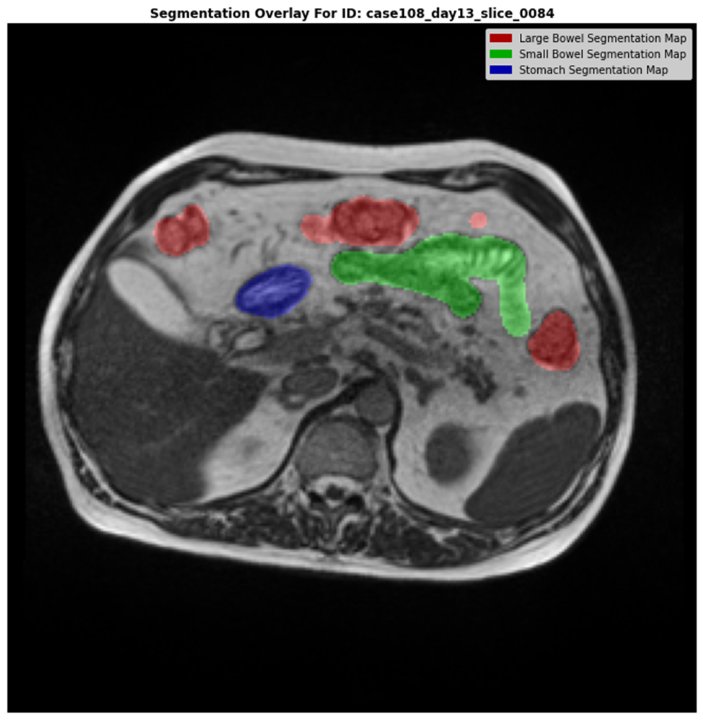
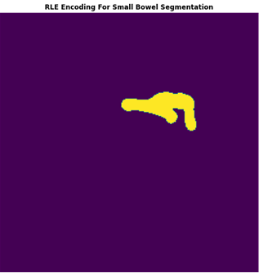
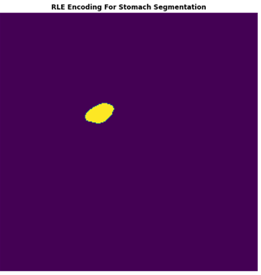
Visualizing MRI scan and masks
MRI Scan
Decoded RLE Masks
Segment Overlay
Notes:
There are 38,496 total images available.
Of these, there are 16,590 (43%) examples with one or more annotations present
There are 2,468 (6.41%) examples with one annotation present.
There are 10,921 (28.37%) examples with two annotations present.
Finally, there are 3,201 (8.32%) examples with all three annotations present
We can also show an image and its mask
Also the test train split (80-20)

Slide 9
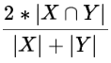
Evaluation Metric – Dice Coefficient
Dice coefficient is one of the most broadly used evaluation metrics in Image Segmentation
The coefficient ranges from 0 to 1; 0 indicating no overlap and 1 indicating complete overlap
It compares the pixel-wise agreement between a predicted segmentation and its corresponding ground truth by calculating the similarity between the two datasets
X and Y are the two datasets to be compared
X ∩ Y represents the number of pixels with the same segment
X + Y are the total number of pixels across the two datasets

Slide 10
Pre-Processing
Creating the training dataset
The masks for Stomach, large bowel and small bowel were available in the RLE format indicating the pixels for the respective object in a CSV file
So, we had to map the image paths and masks in order to overlay the masks on top of the images
Image Resizing
Our dataset had images of 4 different sizes
234 x 234 - < 1%
266 x 266 – 67%
276 x 276 – 3%
310 x 310 – 29%
To create our feature space, we normalized the images and masks to 256 x 256 size
Notes:
Resizing the image
Mapping images with masks
RLE Decoding
Vectorizing the image using keras data generator
Data Augmentation

Slide 11
Pre-Processing
Image Vectorization
We used the Keras Data Generator to vectorize the images to create our feature space
The RLE masks were then decoded to represent the target classes in vectorized format
Train – Test - Validation Split
As Kaggle does not release the test dataset, we split our train dataset using a 90-10 split to create the test set
The training set was then further divided into 5-fold validation set
Notes:
Resizing the image
Mapping images with masks
RLE Decoding
Vectorizing the image using keras data generator
Data Augmentation

Slide 12
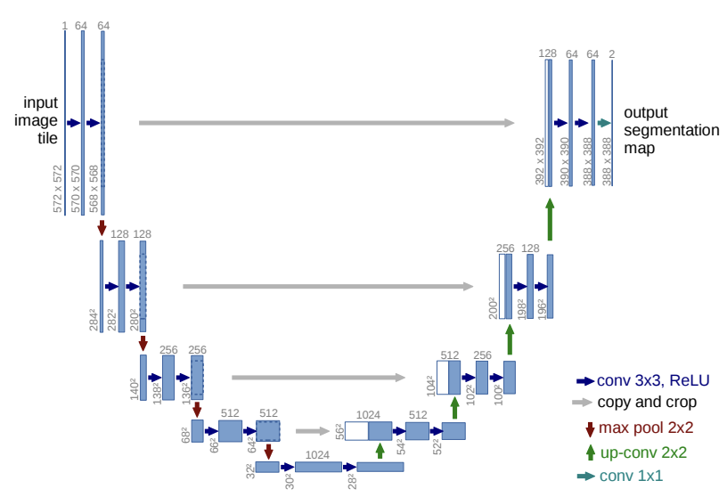
U-Net Model Overview
Encoder Block
Decoder Block
Total Parameters: ~2 M
We tweaked some parameters such as -
convolution layer size (16,32,64,128,256)
added 20% drop out between the convolution layers to avoid overfitting
Image Source: https://arxiv.org/pdf/1505.04597v1.pdf

Slide 13
U-Net Results
The model performance stagnated after 12 Epochs, and we see that the train and validation dice coefficient are ~roughly 0.03, and the IOU coefficient is around 0.02
This model has very poor performance and hence we tried using a more involved architecture to improve the model performance

Slide 14
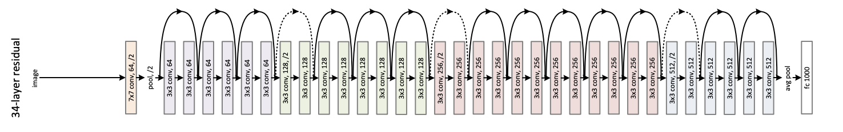
U-Net w ResNet Model Overview
Total Parameters: ~24 M
MIT has developed a package for semantic segmentation (segmentation models) which can use these architectures as backbone to create UNET models.
We trained the model using Resnet-32 as the backbone for UNET and initialized the weights for encoder block using pre-trained ImageNet weights
The model gave significantly better results compared to the vanilla UNET model
Image Source:

Slide 15
U-Net w ResNet Model Results
The model stopped after 11 Epochs, and we see that the train dice coefficient is ~0.8 and validation is ~0.62, however the IOU coefficient is comparable for test and validation sets

Slide 16
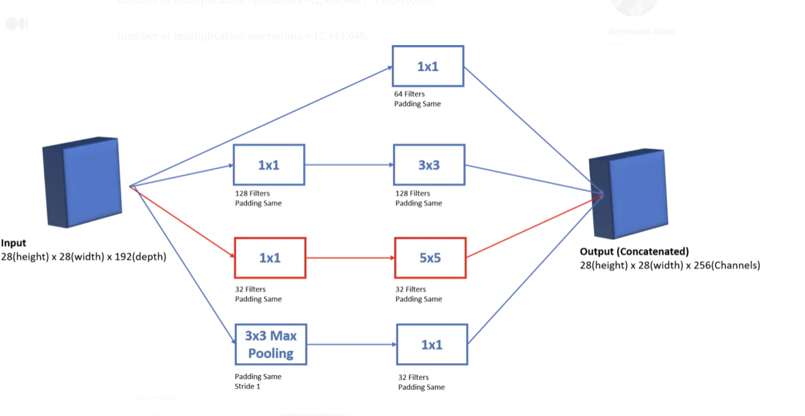
U-Net w Inception Overview
Total parameters: 29.9M
Trainable parameters: 29.8M
Non-trainable parameters: 36K
Reasons
When multiple deep layers of convolutions were used in a model it resulted in the overfitting of the data.
Logic
Inception V1 model uses the idea of using multiple filters of different sizes on the same level
Instead of having deep layers, it has parallel layers thus making model wider rather than making it deeper.

Slide 17
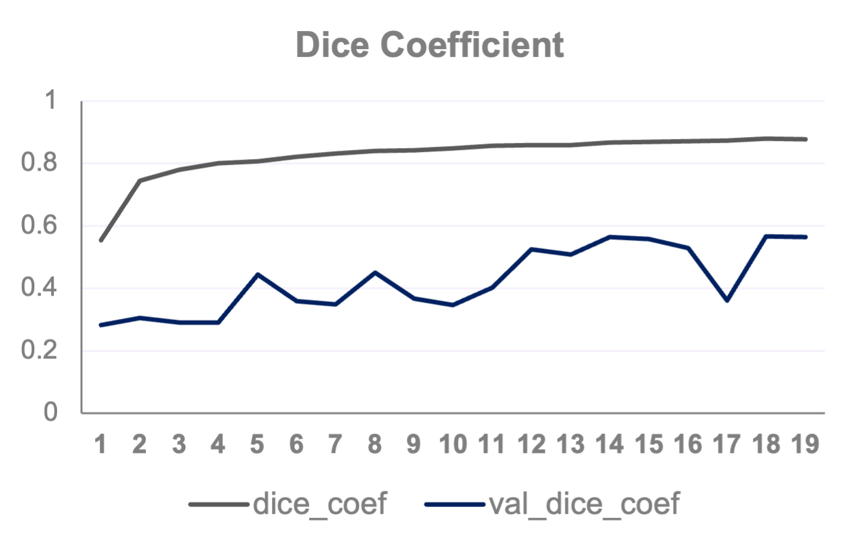
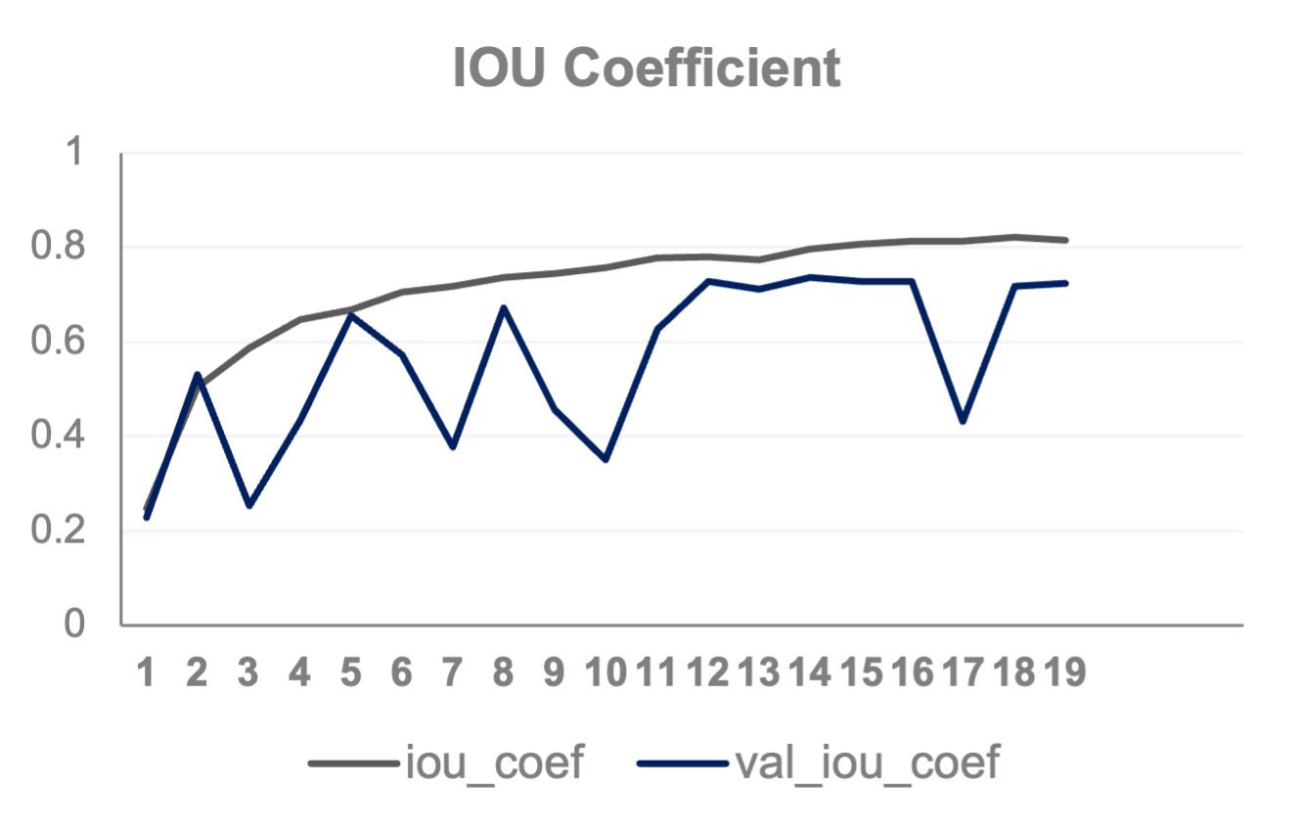
U-Net w Inception Results
The model performance stagnated after 19 Epochs, and we see that the train dice coefficient is ~0.87 and validation is ~0.57, however the IOU coefficient is comparable for test and validation sets

Slide 18
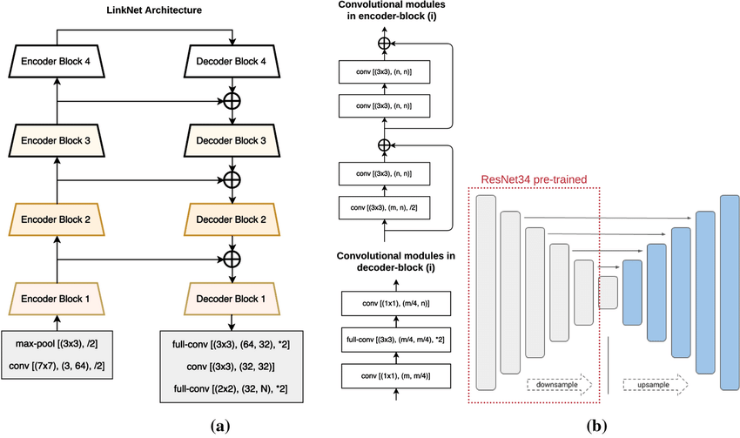
LinkNet w ResNet Model Overview
Total Parameters: 22 M
We trained the model using Resnet-32 as the backbone for LinkNet and initialized the weights for encoder block using pre-trained ImageNet weights
The model gave significantly better results compared to the vanilla UNET model
Image Source: https://www.researchgate.net/publication/354225771_Automatic_segmentation_of_melanoma_skin_cancer_using_transfer_learning_and_fine-tuning

Slide 19
LinkNet w ResNet Model Results
The model performance stagnated after 11 Epochs, and we see that the train dice coefficient is ~0.85 and validation is ~0.63, however the IOU coefficient is comparable for test and validation sets

Slide 20
Comparison of Results
All models gave comparable results; however, we recommend picking LinkNet-Resnet because it is giving slightly better results
Vanilla UNET model gives a very poor performance owing to less complexity

Slide 21
Model performance across segments
We see that the dice coefficient for small and large bowels are comparable close to 60%
Dice coefficient for stomach is higher close to 80%
This makes sense as stomach segment has a relatively larger mask
So, our model is more accurate in segmenting stomach compared to intestines

Slide 22
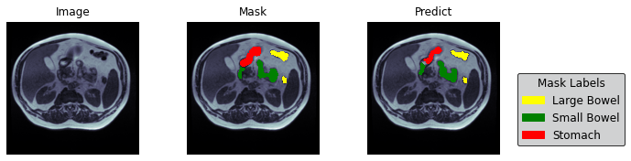
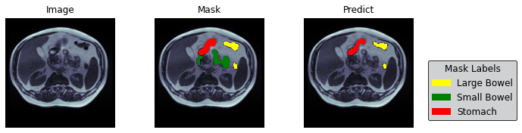
Variation in predictions across models
LinkNet-Resnet
UNET-Inception

Slide 23
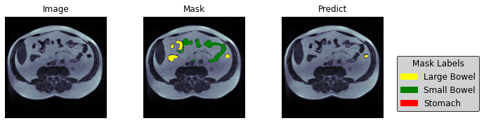
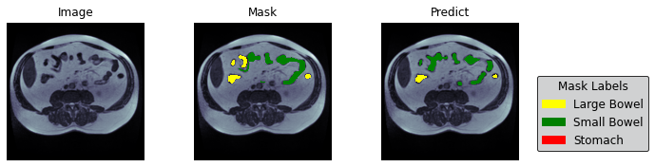
Variation in predictions across models
LinkNet-Resnet
UNET-Inception

Slide 24
Looking Forward…
We can use data augmentation to generate more training data which could potentially improve our model performance
We can also try creating an ensemble of the models we proposed to create a better performing model
Advanced methods such as 3D and 2.5D modelling can improve the model performance
Figure out a way to regularize the UNET/ LinkNet segmentation models to improve out of sample performance

Slide 25
Thank You!

